Slide 1

ENGINEERING CHEMISTRY
Asha A
Department of Science and Humanities

Slide 2

ENGINEERING CHEMISTRY
Module 7- Nanomaterials
Module content:
Nanomaterials (classification and deviation of properties from bulk)
Properties of nanoparticles

Slide 3
ENGINEERING CHEMISTRY
Module 7- Nanomaterials
Class content:
Nanomaterials
Classification of nanoparticles
Deviation in properties of nanomaterials from bulk material- reasons

Slide 4
ENGINEERING CHEMISTRY
Module 7- Nanomaterials
The prefix 'Nano' is derived from the Greek word for
dwarf
1nm = 10⁻⁹m
1nm is approximately the length of 10 H or 5 Si
atoms aligned in a line
Dimensions of nanomaterials lie in between bulk
material and atoms/molecules
Upto μm bulk properties are observed. For smaller
sizes quantum effects are seen as the dimensions
are closer to atoms or molecules

Slide 5
ENGINEERING CHEMISTRY
Module 7- Nanomaterials
Properties of nanomaterials are different from bulk materials
Au-bulk is yellowish in colour, and Au- nanoparticles are red in colour
Al which is stable becomes combustible in the nanoparticle range and is used as solid fuel in rocket propulsion
Melting point of materials is lower in nano-range

Slide 6
ENGINEERING CHEMISTRY
Module 7- Nanomaterials
Nanomaterials: Materials with at least one external dimension between 1 and 100 nm
Nanoscience is the study of phenomena and synthesis, characteristisation, exploration and exploitation of nanostructured materials
Nanotechnologies are the design, characterisation, production and application of structures, devices and systems by controlling shape and size at nanometer scale

Slide 7
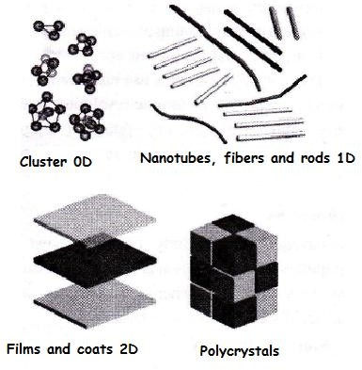
ENGINEERING CHEMISTRY
Module 7- Nanomaterials
Classification of Nanomaterials
Zero dimensional nanomaterials (0D) : Materials having all the dimensions within the nano-range where no dimension is allowed to be outside of nano-range. Like quantum dots, nanoclustures eg. fullerene.
One dimensional nanomaterials(1D): Materials having one of their dimensions out of the nano-range eg. nanotubes , nanowires
Two dimensional nanomaterials (2D) : Materials having two of their dimensions out of the nano-range eg. Nanofilms, nanocoatings
Three dimensional nanomaterials (3D): Materials having all the three dimensions out of the nano-range eg. Dispersions of nanoparticles, bundles of nanowires

Slide 8
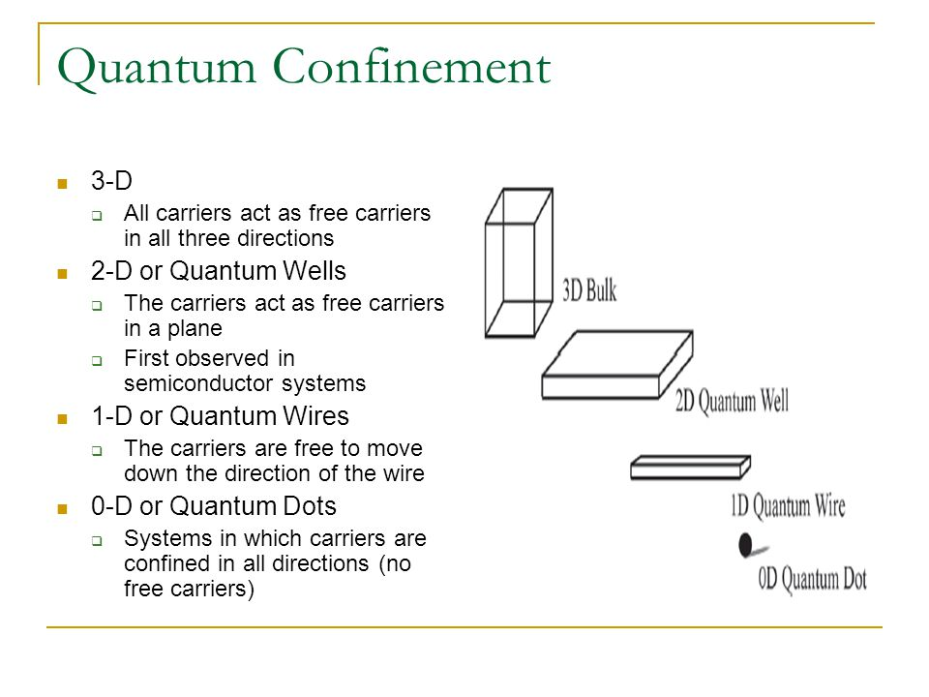
ENGINEERING CHEMISTRY
Module 2- Nanomaterials
Spatial confinement- (quantum confinement)
Source:https://slideplayer.com/slide/5849551/

Slide 9
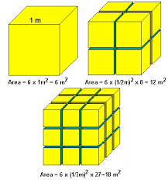
ENGINEERING CHEMISTRY
Module 2- Nanomaterials
Nanomaterials possess specific properties which maybe significantly different from bulk properties
Reasons
Large fraction of surface atoms / unit volume:
Properties are dictated by surface atoms rather than bulk atoms
Eg Pt sheet versus Pt powder
Source:https://nanosense.sri.com/activities/sizematters/introduction/SM_Lesson1Student.pdf
Large surface energy : Surface atoms are held with less force as compared to bulk. Surface activity high .Eg Al

Slide 10
ENGINEERING CHEMISTRY
Module 2- Nanomaterials
Bulk : 1 mole = 10²³ atoms ; Nanomaterials :10-1000 atoms
LUMO
HOMO
CB
VB
Energy gap
Bulk
Nanoparticles
Molecule
Size of particles decreases

Slide 11
ENGINEERING CHEMISTRY
Module 2- Nanomaterials
Reduced imperfections:
Bulk material- metal lattice imperfections like dislocations, kinks etc
Nanomaterial - smaller lattice so less possibility of imperfections

Slide 12
ENGINEERING CHEMISTRY
Module 2- Nanomaterials
Class content:
Properties of Nanomaterials
Surface area dependant properties
Electrical properties
Optical properties

Slide 13
ENGINEERING CHEMISTRY
Module 2- Nanomaterials
Properties of Nanomaterials
Properties of any bulk material are independent of its size whereas properties of nanomaterials change with size
Properties of a bulk material can be altered only by altering their structure and composition

Slide 14
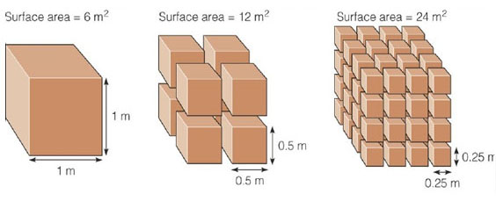
ENGINEERING CHEMISTRY
Module 2- Nanomaterials
Surface Area dependant properties
Many physical and chemical properties of a material depend on its surface properties
Surface area is enormously increased on moving from bulk to nano scale.
Nanomaterials have a significant proportion of atoms existing at the surface
Properties like catalytic activity, gas adsorption depend on surface area
e.g. Bulk gold is catalytically inactive but gold nanoparticles are catalytically very active for selective redox reactions
Surface energy is also high so chemical reactivity is high
e.g. Aluminum becomes combustible
Source:https://ninithi.wordpress.com/nanoscale-why-size-matter/

Slide 15
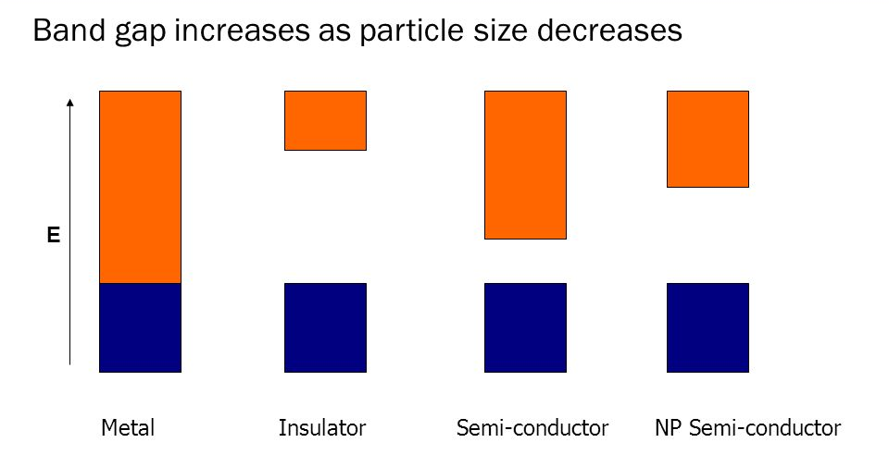
ENGINEERING CHEMISTRY
Module 2- Nanomaterials
Electrical Properties
Electrical conductivity decreases for nanoparticles as compared to bulk material
Due to spatial confinement
The electronic bands in bulk material are continuous
In nano size materials the electronic bands become discrete and the band gap increases
Some metals which are good conductors in bulk become semiconductors and insulators as their size is decreased to nano range
Source:https://www.mknano.com/info-guide/what-are-nanoparticles.aspx

Slide 16
ENGINEERING CHEMISTRY
Module 2- Nanomaterials
Due to surface scattering
Electrical conductivity decreases due to surface scattering
Electrons have a mean free path
If dimensions of the nanomaterial is smaller than the mean free path of the electron, elastic or inelastic surface scattering can happen
Elastic scattering will not affect conductivity but when inelastic scattering happens, the scattered electron loses its velocity and electrical conductivity decreases

Slide 17
ENGINEERING CHEMISTRY
Module 2- Nanomaterials
Optical Properties
Nanomaterials show unique optical properties
Colour depends on the size of the particles
Due to Surface Plasmon Resonance
Due to increase in band gap

Slide 18
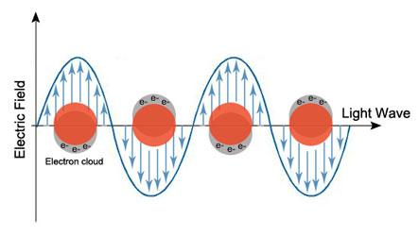
ENGINEERING CHEMISTRY
Module 2- Nanomaterials
Surface plasmon resonance (SPR)
Metals have positive lattice points surrounded by a sea of electrons
When radiation falls, the surface electrons are polarised
These electrons oscillate with a frequency
Collective oscillations of these electrons is called Plasmons
When the plasmon frequency matches with the frequency of radiation falling, resonance occurs and radiation is absorbed and the material appears coloured
Plasmon frequency depends on size, shape and nature of metal
As size of nanoparticle changes, colour changes
Soiurce:https://www.cytodiagnostics.com/pages/gold-nanoparticle-properties

Slide 19
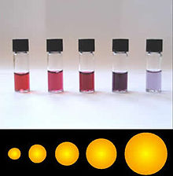
ENGINEERING CHEMISTRY
Module 2- Nanomaterials
Increase in Energy gap
Increases in energy gap between the valence band and conduction band
As size of nanoparticles decreases the energy gap increases and the wavelength of light absorbed moves towards smaller values . This is referred to as ‘blue shift’
eg. colloidal suspensions of gold nanoparticles :
Gold spheres of > 50 nm absorb at λ = 575 nm
Gold spheres of 10- 20 nm absorb at λ = 524 nm
Gold spheres of 2-5 nm absorb at λ = 517 nm
Source::https://en.wikipedia.org/wiki/Colloidal_gold

Slide 20
ENGINEERING CHEMISTRY
Module 2- Nanomaterials
Class content:
Properties of Nanomaterials(contd.)
Mechanical properties
Thermal properties
Magnetic properties
Applications

Slide 21
ENGINEERING CHEMISTRY
Module 2- Nanomaterials
Mechanical properties
Strength of nanomaterials is greater than bulk material
Mechanical properties may reach theoretical strength , which is one or two orders of magnitude higher than that of the bulk materials.
e.g bending of bulk Cu happens readily but Cu particles < 50 nm are considered super hard materials that do not show same malleability and ductility as bulk Cu.
The reason for this high strength is due to reduced probability of defects Large lattices in bulk materials have imperfections like dislocations, kinks and vacancies but for lattice with smaller cross-section, there is less probability of finding imperfections.

Slide 22
ENGINEERING CHEMISTRY
Module 2- Nanomaterials
Thermal properties
Low melting point and phase transition temperature
Due to a large fraction of surface atoms compared to bulk.
Atoms or molecules on the surface are bound by lesser number of bonds as compared to the atoms in the bulk.
the number of bonds need to be broken per atom during melting is less in nanomaterials
Decrease in thermal conductivity
Size of the particles is smaller than the path length of phonons arising due to lattice vibrations .
Phonon scattering results in decrease in thermal conductivity

Slide 23
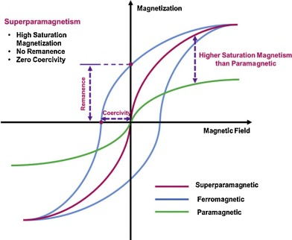
ENGINEERING CHEMISTRY
Module 2- Nanomaterials
Magnetic Properties
Magnetic properties of nanomaterials are distinctly different from that of the bulk materials.
In ferromagnetic materials like Fe,Co,Ni , ferromagnetism changes to superparamagnetism in the nanometer scale due to the high surface energy. The domains can flip directions . In the presence of magnetic field ,they get magnetised with high susceptibilities.
Bulk gold and platinum are non-magnetic but at the nanosize they act as magnetic particles
Source:https://www.sciencedirect.com/science/article/pii/S1674200116300852

Slide 24
ENGINEERING CHEMISTRY
Module 2- Nanomaterials
Applications of Nanomaterials
Medicine
Energy storage
Catalysis
Consumer Electronics
Cosmetics
Environment

Slide 25
ENGINEERING CHEMISTRY
Module 2- Nanomaterials
Applications
Medicine:
for targeted drug delivery to enhance effectiveness, injectible nanobots which can serve as detectors, informers of early disease and perhaps repair metabolic defects
antibacterial activity - Ag nanoparticles
Energy storage:
as electrodes in fuel cells- high surface area
Catalysis:
Nanocrystalline materials have very large surface area due to their
small size. Therefore, they are very active with regards to their physical,
chemical, and mechanical properties
Au, Ag nanoparticles – good catalysts
Oxygen reduction reaction catalysts for fuel cells & metal-air batteries
CO oxidation catalyst

Slide 26
ENGINEERING CHEMISTRY
Module 2- Nanomaterials
Consumer electronics:
Nanophosphors for good resolution in HDTV- The resolution of a monitor or television is subject to the size of the pixel. These pixels are fundamentally composed of materials known as “phosphors,” which glow when struck by a stream of electrons within the cathode ray tube (CRT). The resolution enhances with a reduction in the pixel size or the phosphors. Nanocrystalline zinc selenide, cadmium sulfide, zinc sulfide, and lead telluride are potential materials for enhancing the resolution of monitors
Nanophosphors in white light emitting diode

Slide 27
ENGINEERING CHEMISTRY
Module 2- Nanomaterials
Environment:
Elimination of pollution using catalytic converters - Owing to their improved chemical activity, nanomaterials can be employed as catalysts to react with toxic and noxious gases such as nitrogen oxide and carbon monoxide, in power generation equipment and automobile catalytic converters, to avoid environmental pollution caused when gasoline and coal are burnt.
Water purification by Carbon nanotubes
Cosmetics:
ZnO and TiO₂ in sunblocks

Slide 28
ENGINEERING CHEMISTRY
Module 2- Nanomaterials
End of Module 7 – Nanomaterials

Slide 29
THANK YOU
Asha A
Department of Science and Humanities

